Slide 1



SENTIMENT ANALYSIS - AMAZON APPLIANCE REVIEWS
MILESTONE #4
TEAM: GOURI KULKARNI JUSTINO CALVILLO

Slide 2
PROBLEM STATEMENT
To analyze customer feedback using ML. Customer buys an appliance and writes a review.
Amazon Appliance Reviews dataset will be used to train and test ML methods
Our goal is getting the best ML method to predict if an incoming review is either positive or negative.

Slide 3
AGENDA
First Iteration: Evaluate different Models and select one.
Second Iteration: Freeze the Model and evaluate different numbers of most important features.
Third Iteration: Tuning the parameters
Fourth Iteration: Freeze the selected number of features and use them in different Models

Slide 4
FIRST ITERATION - SUMMARY
Review Train 800
Review Test 200
Overall Train 800
Overall Test 200
Shape of train vectors (800, 2843)
Shape of test vectors (200, 2843)
Accuracy for each model with full set of features
Shape of train vectors (800, 2843)
Shape of test vectors (200, 2843)
BASE ESTIMATOR RANDOM FOREST ACCURACY 86%
From 4 models to choose the best model
Dataset has the full set of features
Benchmark accuracy & learning curves
Words unigram (1,1)

Slide 5
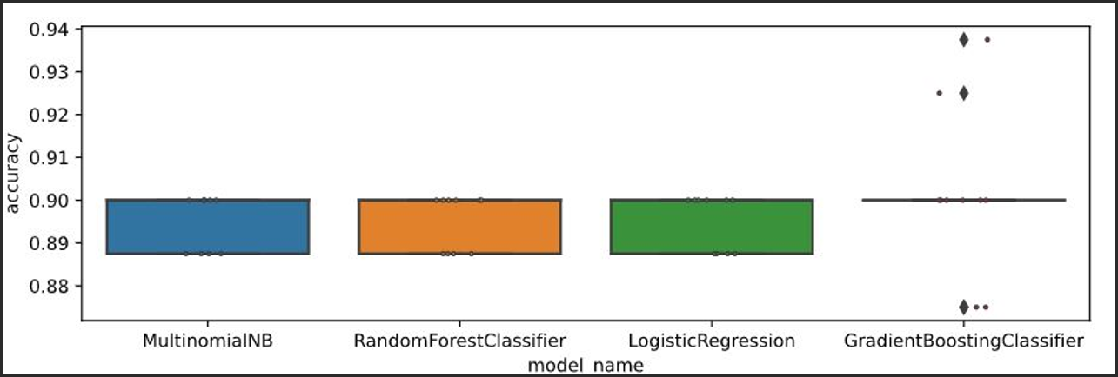
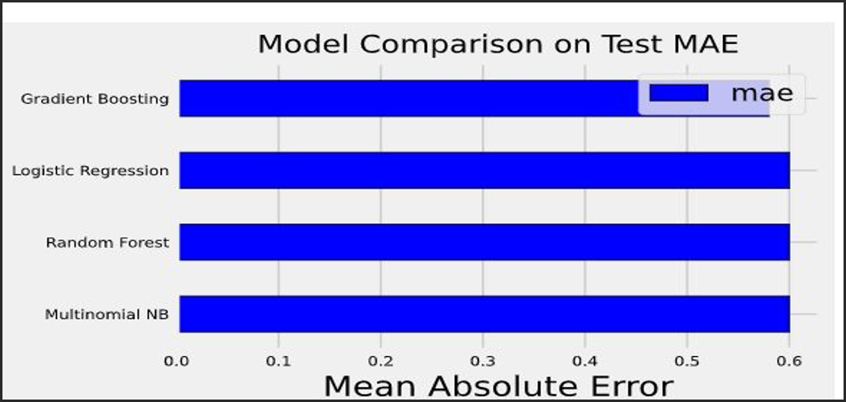
FIRST ITERATION
Accuracy for each model with full set of features
Shape of train vectors (800, 2843)
Shape of test vectors (200, 2843)
Accuracy score for MultinomialNB 0.85
Accuracy score for RandomForestClassifier 0.85
Accuracy score for LogisticRegression 0.85
Accuracy score for GradientBoostingClassifier 0.855
MAE for each model with full set of features
Shape of train vectors (800, 2843)
Shape of test vectors (200, 2843)
MAE for MultinomialNB 0.6
MAE for RandomForestClassifier 0.6
MAE for LogisticRegression 0.6
MAE for GradientBoostingClassifier 0.58

Slide 6
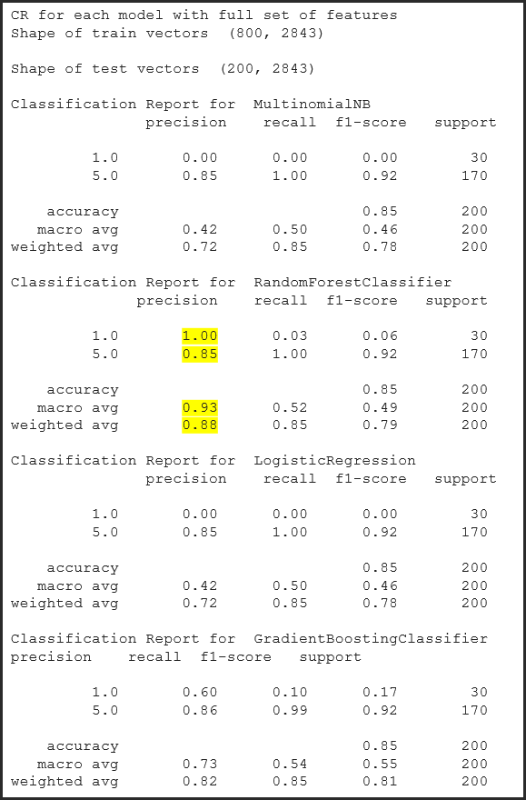
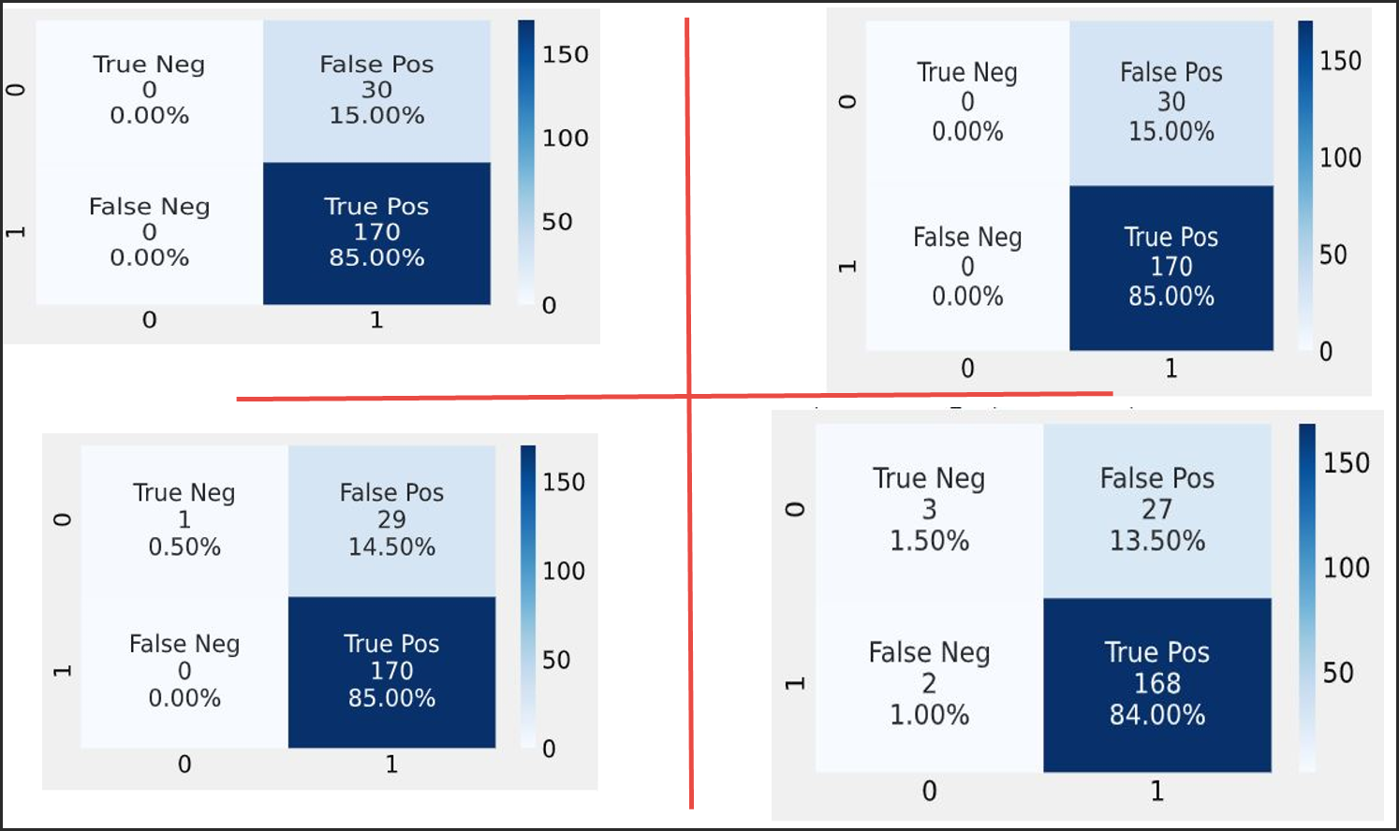
FIRST ITERATION
Accuracy tp + tn/ all
Precision Proportion of predictions actually correct
TP/ All positives
RF chosen because it gave a good precision score on both good and bad reviews
When it predicts, it is correct most of the time
As our classes are balanced via random oversampling , and a true positive or true negative review prediction could impact the business , we use accuracy
Had we used the unbalanced set, we could have used f1 score but it would have resulted in biased predictions

Slide 7
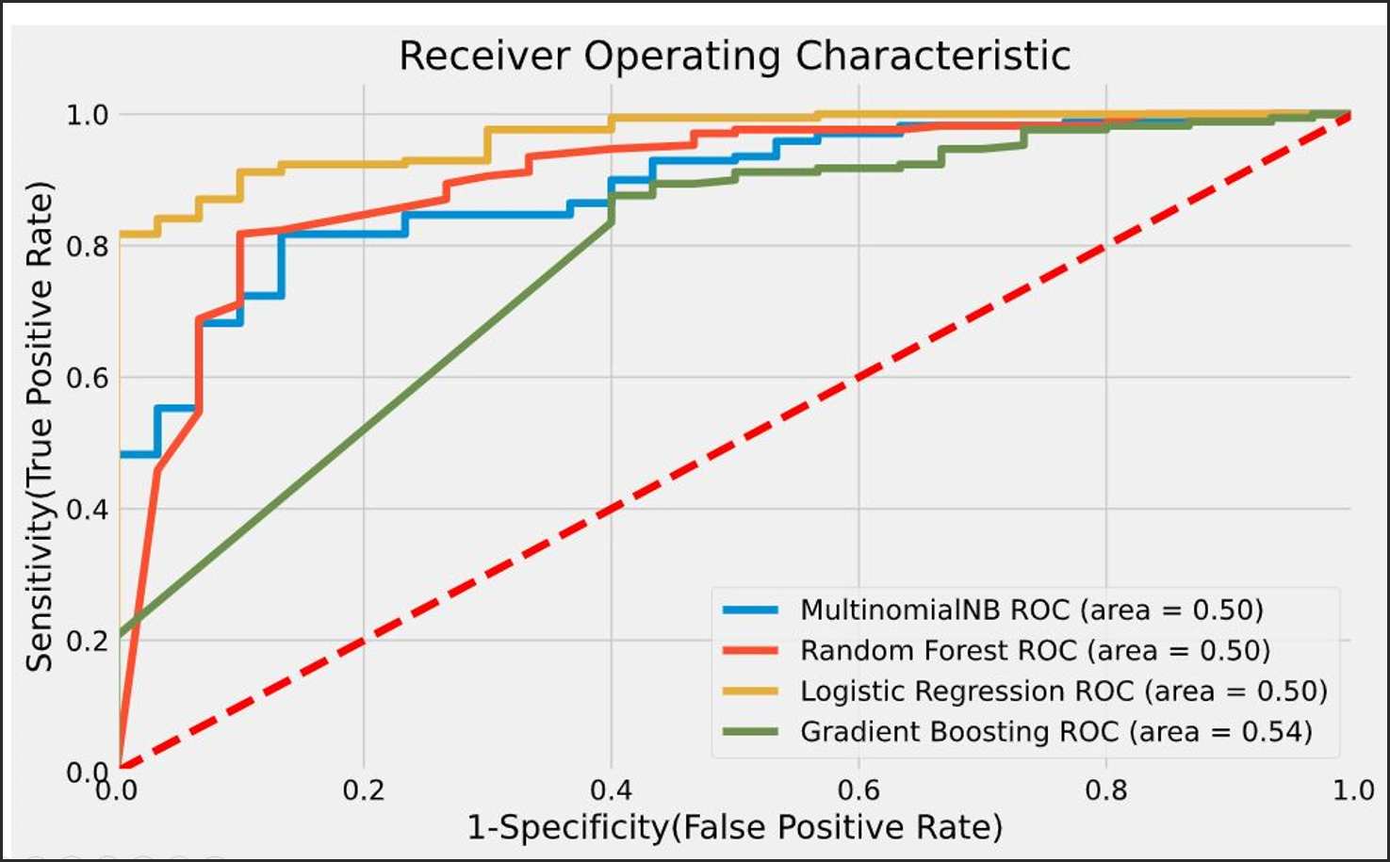
FIRST ITERATION
Tradeoff between tpr and (1- fpr)
Or sensitivity and specificity
ROC does not depend on class distribution unlike f1 score
Though Random forest scored lower than LR , LR may perform worse

Slide 8
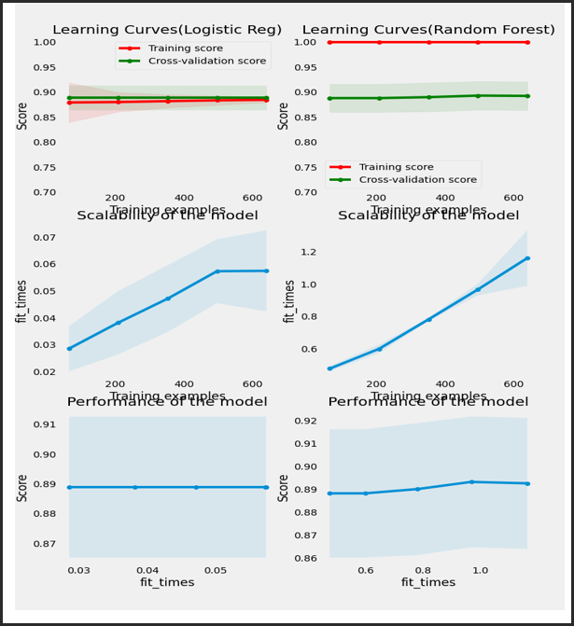
FIRST ITERATION
As lr and rf results were close for AUC and F1 we went on to plot the learning curves
The results were similar
Next step :
Iteration 2 -feature selection and model interpretation

Slide 9
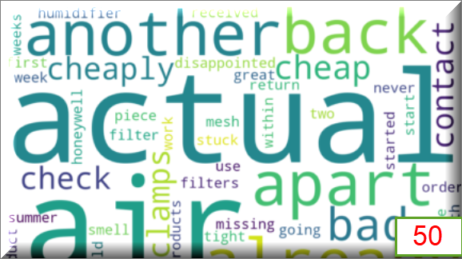
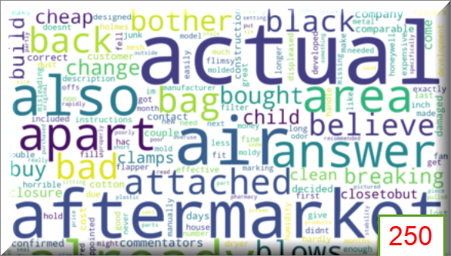

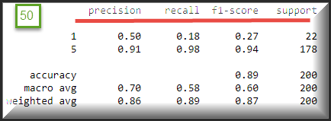
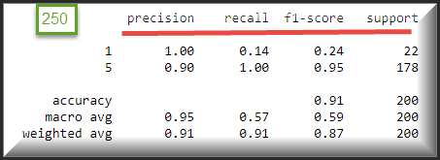
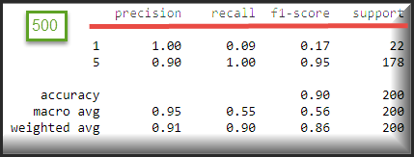
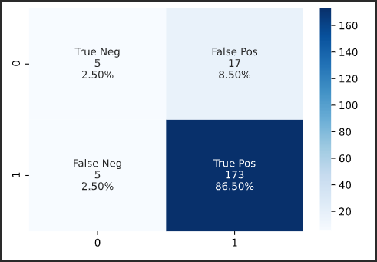
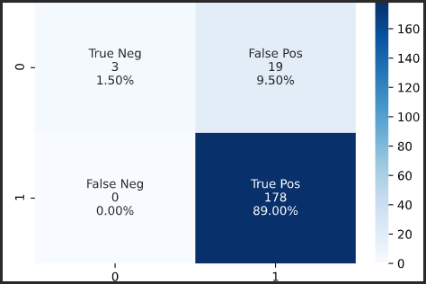
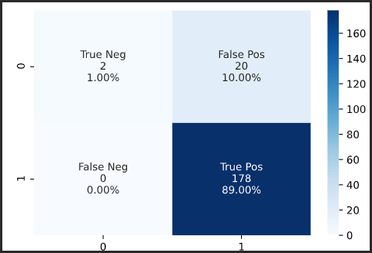
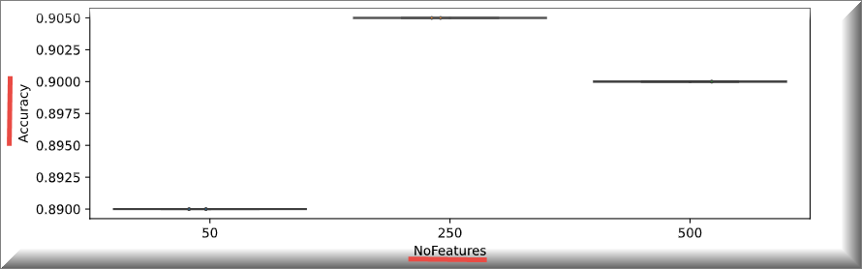
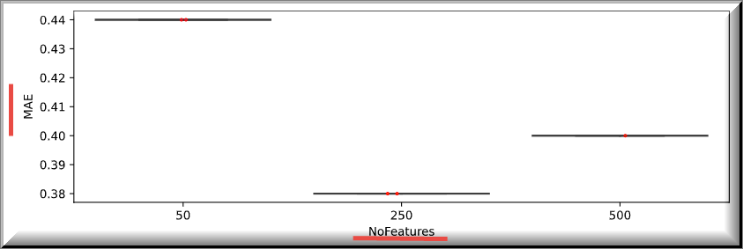
SELECTED MODEL: RANDOM FOREST SELECTED FEATURES: 50, 250, 500 FOR RFE DATASET: 1000
SECOND ITERATION – FEATURE SELECTION
Conclusions:
For the Random Forest 250 is the best number of features taken from the RFE
Accuracy is the highest, MAE the lowest.

Slide 10
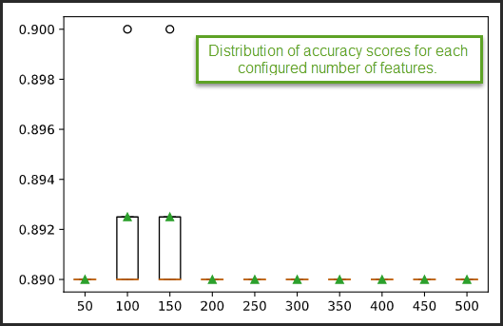
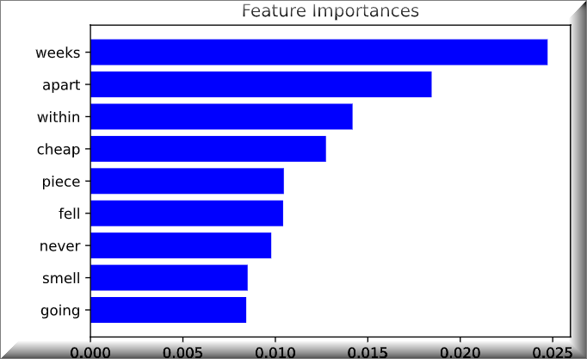
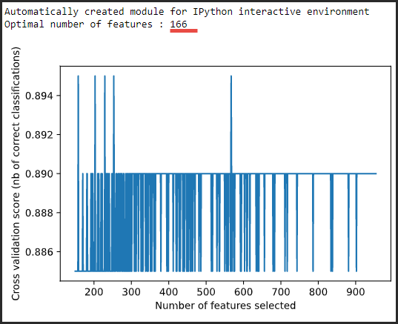
SELECTED MODEL: RANDOM FOREST SELECTED FEATURES: 50, 250, 500 FOR RFE DATASET: 1000
SECOND ITERATION – FEATURE SELECTION
Conclusions:
RFE was run for a range (50,500) features
Best accuracy happened for 150 features but this result was not the same as the 91 getting with 250

Slide 11
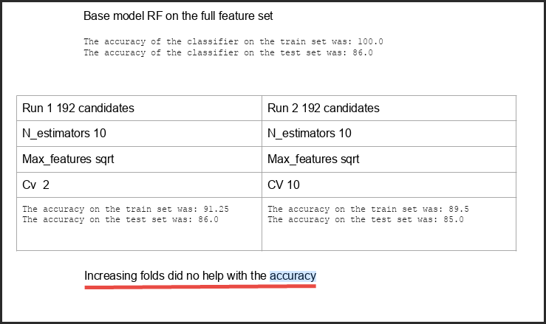
THIRD ITERATION
We tuned the model, cross validated the results, evaluated the performance on the train and test set
Grid search CV to validation to estimate model accuracy on unseen data
Results with 10 estimators and two different folds

Slide 12
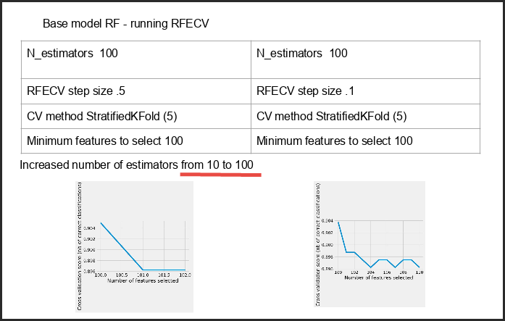
THIRD ITERATION
Feature selection to drop unwanted features

Slide 13
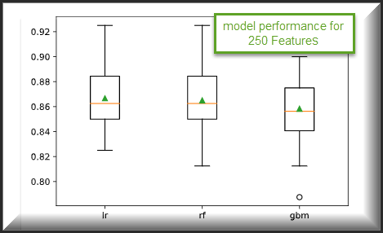
FORTH ITERATION
RFE with 250 features running with wrapped algorithms
And three ML methods

Slide 14
THANK YOU

